Slide 1
Introduction to OGC API Common 16 April 2020
Open Geospatial Consortium

Slide 2
Overview
OGC API-Common is a family of standards
Core (mature draft)
Collections (in-work)
Crs (proposed)
Others as identified
This family of standards define API modules which can be used to build OGC API standards.

Slide 3
Part 1: The core

Slide 4
Scope
This specification identifies resources, captures compliance classes, and specifies requirements which are applicable to all OGC API standards. It should be included as a normative reference by all such standards.

Slide 5
The Landing Page
The starting point for navigating an API
Returned by “GET /”
Provides links to
The `API definition` (path `/api`),
The `Conformance` statements (path `/conformance`),
Landing Page Schema

Slide 6
Landing Page Example
{
"title": "Buildings in Bonn",
"description": "Access to data about buildings in the city of Bonn via a Web API that conforms to the OGC API Features specification.",
"links": [
{
"href": "http://data.example.org/?f=html",
"rel": "alternate",
"type": "text/html",
"title": "this document in HTML",
},
{
"href": "http://data.example.org/api?f=json",
"rel": "service-desc",
"type": "application/vnd.oai.openapi+json;version=3.0",
"title": "the API definition in OpenAPI 3.0 JSON",
},
{
"href": "http://data.example.org/conformance?f=json",
"rel": "conformance",
"type": "application/json",
"title": "the list of conformance classes implemented by this API",
}
]
}

Slide 7
API Definition
Provides a detailed description of the API
Returned by:
“GET /api”
Following the “service-desc” link from the landing page OR
Following the “service-doc” link from the landing page
Only OpenAPI 3.0 is currently supported
Other options may be added in the future
OpenAPI Introduction

Slide 8
Conformance
Identifies the conformance classes supported by this API
Returned by:
“GET /conformance”
Following the “conformance” link from the landing page
Returned document is a list of URIs for the conformance classes
Conformance Schema

Slide 9
Conformance Example
{
"conformsTo": [
"http://www.opengis.net/spec/ogcapi-features-1/1.0/conf/core",
"http://www.opengis.net/spec/ogcapi-features-1/1.0/conf/oas30",
"http://www.opengis.net/spec/ogcapi-features-1/1.0/conf/html",
"http://www.opengis.net/spec/ogcapi-features-1/1.0/conf/geojson"
"http://www.opengis.net/spec/ogcapi-features-1/1.0/conf/gmlsf0"
]
}

Slide 10
Part 2: collections

Slide 11
Scope
This standard provides a common connection between the API landing page and resource-specific details. That connection includes metadata which describes the hosted resources, common parameters for selecting subsets of the hosted resources, and URI templates for identifying the above.
Remember:
This standard is still in-work.
This is a separate conformance class from the Core.

Slide 12
Collections
The starting point for the resource-specific paths
Returned by:
“GET /collections”
Following the “data” link from the landing page
Returned document contains:
A link to itself
A link to each alternate encoding of the document
An array of Collection Metadata records
Collections Schema

Slide 13
Collection Metadata
Describes a collection
Included in the Collections response
Also returned by:
“GET /collections/{collectionId}”
Metadata includes:
A local identifier for the collection that is unique for the dataset
A list of coordinate reference systems (CRS) in which geometries may be returned by the server
An optional title and description for the collection
An optional extent that can be used to provide an indication of the spatial and temporal extent of the collection - typically derived from the data.
Collection Metadata Schema

Slide 14
Extent
Defines a spatial-temporal boundary for the collection
Spatial extent is a bounding box.
Temporal extent is a date-time or a period.
May include spatial and temporal CRS.
Extent Schema

Slide 15
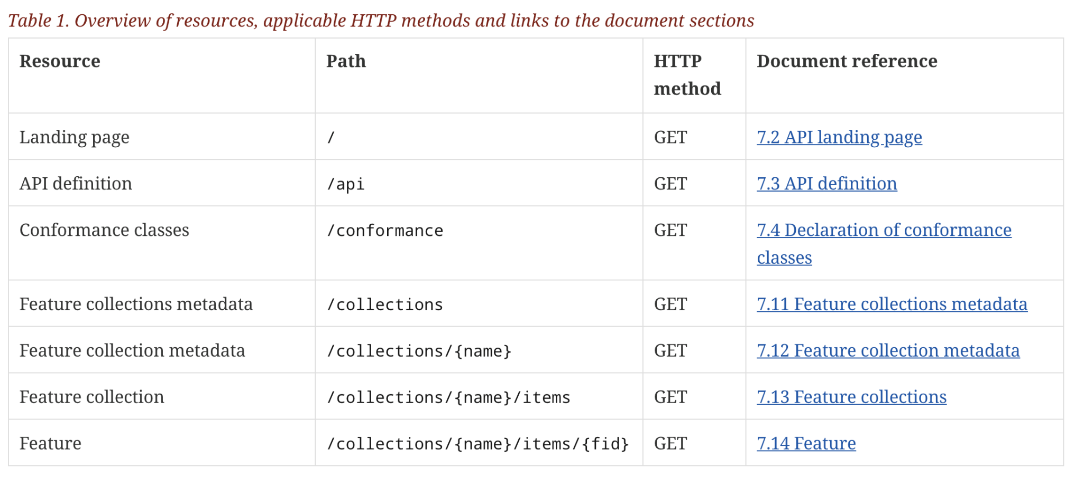
Example: API Common- Features
information
about the API
a dataset with a sub-division into
named collections of features
the features
Only the feature resources are specific to a “feature service”

Slide 16
cheazel@wiscenterprises.com
Questions?

